Slide 1
Stream Ciphers

Slide 2
Functions (basic mathematics)
A function F : X → Y is a mapping of elements in the set X (called the domain) to elements in the set Y (called the range or co-domain)
Suppose that F(x) = y, then y is called the image of x, and x is called the pre-image of y
A function F : X → Y is called injective or one-to-one if every element in Y has at most one pre-image (i.e., every element in Y has zero or one elements from X mapped to it)
A function F : X → Y is surjective or onto if every element in Y has at least one pre-image (i.e., every element in Y has one or more elements from X mapped to it)
A function F : X → Y is bijective if it is both injective (one-to-one) and surjective (onto)
  This means that every element of the co-domain is mapped to by exactly one element of the domain
  For F to be bijective, it is necessary that |X|= |Y|
  If X = Y then the function F is called a permutation on X

Slide 3
Types of mappings
Injective
Surjective
Bijective
X
1
2
3
4
Y
1
2
3
4
5
6
X
1
2
3
4
5
6
Y
1
2
3
4
X
1
2
3
4
5
6
Y
1
2
3
4
5
6

Slide 4
Stream Ciphers
A stream cipher has a secret internal memory state which is used to derive a keystream unit
In each time step (clock cycle, sometimes shortened to just cycle), a keystream unit is output and the memory state is updated:
  The keystream unit is derived from the memory state through a nonlinear function called the keystream generator
  The memory state is then updated through a function called the memory update function
If we denote the memory state after i clock cycles by K_{i}, then
K_{i+1} = F(K_{i})
where F is the stream cipher function to update the memory state
The keystream unit (usually one bit or one byte, but may extend to larger units) is combined with the plaintext in some manner though some combiner mechanism
The most common combiner mechanism is the use of exclusive-or:
C_{i} = P_{i}  G(K_{i})
where C_{i} is the i-th ciphertext unit, P_{i} is its corresponding plaintext, and G is the keystream generator
The user-specified secret key is used to set the initial state of the memory; a function that initialises the stream cipher memory according to the secret key (specified by the user) is called a key setup function:
  K₀ = H(K)
  where K₀ is the initial state of the cipher memory, and K is the user key

Slide 5
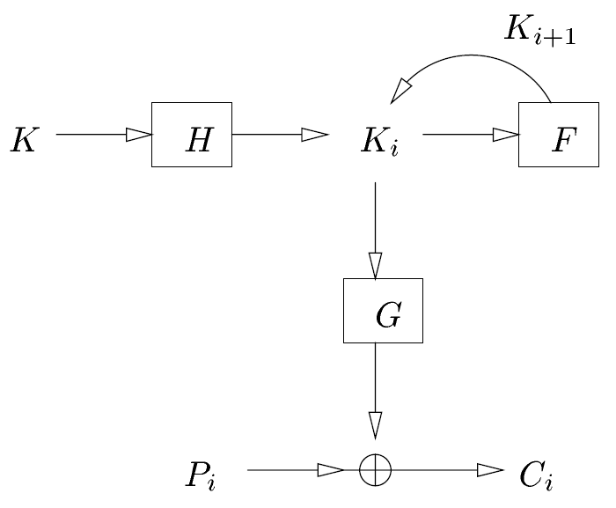
General model of a stream cipher

Slide 6
General Properties
The memory state may be much larger than the user key, meaning that key management may be more complicated if the cipher does not have a simple method to initialize the memory state from the user key
  For example, if a cipher with no key setup function has a memory state which is required to be a permutation of the integers modulo 256, also known as Z_{256,} (such as in the RC4 cipher, described later) then the user would have to choose keys that satisfy this requirement and this may not be easy or convenient for them (memorizing a passphrase is easier than memorizing a sequence of 256 distinct integers)
The key setup (function H) may be designed to be relatively slow to execute so that an attempt of an exhaustive search for the user key K would also be slow
There might be some memory states that are “weaker” than others (in that an attacker may be able to easily deduce some information about the memory state purely from observation of the keystream); the key setup should make it less likely for the memory state to be initialised incorrectly.
  For instance, the memory state of the stream cipher RC4 is meant to be a permutation of the integers in Z₂₅₆, but the cipher would be weakened if this condition is not met (e.g., if the memory state contained the same element throughout).
If the user key is known to an attacker, they can derive the memory state; if the memory state is known to an attacker, they can generate the keystream (and hence the cipher is broken)

Slide 7
Period of a stream cipher
The period of a stream cipher is the number of clock cycles it takes for the memory state to return to a state that it has already visited
If the period is p, then after p clock cycles, K₀ = K_{p} which means that there are only p distinct states corresponding to the given key
In order to ensure that a stream cipher has a high period, we usually require the memory update function F to be a permutation
The maximum period of the cipher is then the length of the longest cycle of the permutation
By building the function F from simple linear functions whose cycle lengths are known, we can calculate the maximal period of the memory update function (usually as the product of the maximum cycle lengths of the linear component functions)
The period of the keystream generated by a particular key would actually depend on the length of the cycle that contains the initial state of the cipher

Slide 8
Linear Feedback Shift Registers
An n-stage linear feedback shift register (n-stage LFSR) is an n-bit binary register A = (a_{n–1}, …, a₀), with the following update rule a_{i} = a_{i–1}, for all i > 0, and a₀ = L(A), where L is a linear function mapping n bits to one bit (the sum of selected bits in the register, normally including the most significant bit)
This can be represented as a left shift of the register with the least significant bit set as the linear function of the bits of register before it is shifted
In each clock cycle, the most significant bit of the register before it is shifted (a_{n–1}) is output
A maximum-length LFSR is an n-stage LFSR that has a period of 2^{n}–1, the maximum period attainable for a standard LFSR
A maximum-length LFSR cycles through all non-zero states when initialised with a non-zero state

Slide 9
Feedback Coefficients
The function L computes the XOR of certain bits of its input: L(A) = c₀a₀ + c₁a₁ + … + c_{n–1}a_{n–1} (mod 2)
where the c_{i}'s are the feedback coefficients (or feedback taps) that determine which bits of the register are to be summed
The feedback taps can be expressed in terms of the feedback polynomial (or connection polynomial), which is defined by:
C(x) = 1 + c₀x¹ + c₁x² + … + c_{n–1}x^{n}
For an LFSR to generate sequences of maximal length (also known as m-sequences) the connection polynomial associated with the LFSR must be primitive over GF(2)

Slide 10
Example: LFSR diagrams
connection polynomial = x⁴ + x + 1
output
connection polynomial = x⁴ + x³ + 1
output

Slide 11
LFSR-based stream ciphers
Traditionally, modern digital stream ciphers have been based on LFSRs because they have a number of properties which make them particularly suitable for use in cryptography:
  They are very simple, fast and very economical in power when implemented in hardware (the hardware efficiency of a cipher is an important consideration if the cipher is to be fielded in a low-power situation, such as in mobile phones)
  They are easy to model mathematically, and there are numerous results proving certain properties about them that are useful in cryptography (e.g., they have good statistical pseudo-randomness properties and they can produce sequences with a large period)
LFSRs are usually implemented as the memory state in a stream cipher (because the update function is very simple and the LFSR can be guaranteed to generate an m-sequence).

Slide 12
Example: LFSR cipher
Stream cipher is a 4-stage LFSR with connection polynomial x⁴ + x + 1 (binary 10011)
Let the key K = (1010), then the initial state of LFSR = K = (1010)
Generate keystream:
  Cycle LFSR Output
  0 1010 -
  1 0101 1
  2 1011 0
  3 0111 1
  4 1111 0
  5 1110 1
  6 1100 1
  7 1000 1
  8 0001 1
  9 0010 0
  10 0100 0
  11 1001 0
  12 0011 1
  13 0110 0
  14 1101 0
  15 1010 1
LFSR produces m-sequence (keystream) with period 15: 101011110001001
This keystream is exclusive-ORed with the binary plaintext
Example:
  Plaintext: 01001000 01000101 01001100 01001100 01001111 (48 45 4C 4C 4F, “HELLO”)
  Keystream: 10101111 00010011 01011110 00100110 10111100 (AF 13 5E 26 BC)
  Ciphertext: 11100111 01010110 00010010 01101010 11110011 (E7 56 12 6A F3)
output

Slide 13
Multiple LFSR-based stream ciphers
Most of the modern LFSR-based stream ciphers use more than one LFSR for the memory state, and the LFSRs have lengths that are relatively prime to one another
This ensures that the period of the cipher will be the product of the maximum cycle lengths of each LFSR (assuming that none of the LFSRs is initialised with a value of zero, which would lower the period)
The keystream generator is usually a non-linear function mapping the bits from the LFSRs to a one bit keystream unit. For instance, a threshold generator stream cipher uses three LFSRs for the memory state and uses the non-linear keystream generator function G(a,b,c) = ab  ac  bc mapping the three bits (a,b,c) from the LFSRs to a one-bit keystream unit
In the threshold generator, the output bit equals one if at least two of a, b, or c equals one (hence the name of the generator)
The threshold generator is one example of an LFSR-based stream cipher, but it is not secure (it can be broken using a correlation attack); more recent LFSR-based ciphers use more sophisticated schemes, including irregular clocking or irregular output

Slide 14
Example: Threshold Generator
3 LFSRs of lengths 3, 4 and 5 with primitive connection polynomials: keylength = 3+4+5 = 12
Period of keystream (assuming that none of the LSFRs is initialised to zero) = (2³–1)(2⁴–1)(2⁵–1) = 7x15x31 = 3255
Non-linear generator function is the binary threshold (or majority) function G(a,b,c) = ab ⊕ ac ⊕ bc :
G(0 0 0)=0
G(0 0 1)=0
G(0 1 0)=0
G(0 1 1)=1
G(1 0 0)=0
G(1 0 1)=1
G(1 1 0)=1
G(1 1 1)=1
a
non-linear filter
G(a,b,c)
b
c

Slide 15
The RC4 stream cipher
Within the past 20 years, a few stream ciphers have been proposed that use unconventional designs
One such cipher is the RC4 stream cipher, designed by Ronald Rivest in 1987, and used in the SSL (Secure Sockets Layer) protocol and some commercial software applications (such as Microsoft Office 2000)
The operation of the RC4 cipher was a trade secret of RSA Data Security Inc., a cryptographic consulting company in the USA, but it was reverse engineered from a software implementation and the reverse engineered cipher, sometimes known as Alleged RC4, was verified to be functionally equivalent to the official RC4.
RC4 is used for encryption in WEP and WPA, the data privacy schemes used in IEEE 802.11 wireless networks (WiFi)

